Slide 1
Skin Disease Prediction
Using Deep Learning

Slide 2
Table of contents
01
02
03
04
05
06
Abstract
Base Paper
Introduction
Existing System
Proposed System
Disadvantages of Existing system

Slide 3
Table of contents
07
08
09
10
11
12
Literature Survey
Execution and Result
Advantages Of
Proposed System
Project Flow
Conclusion
Future Scope

Slide 4
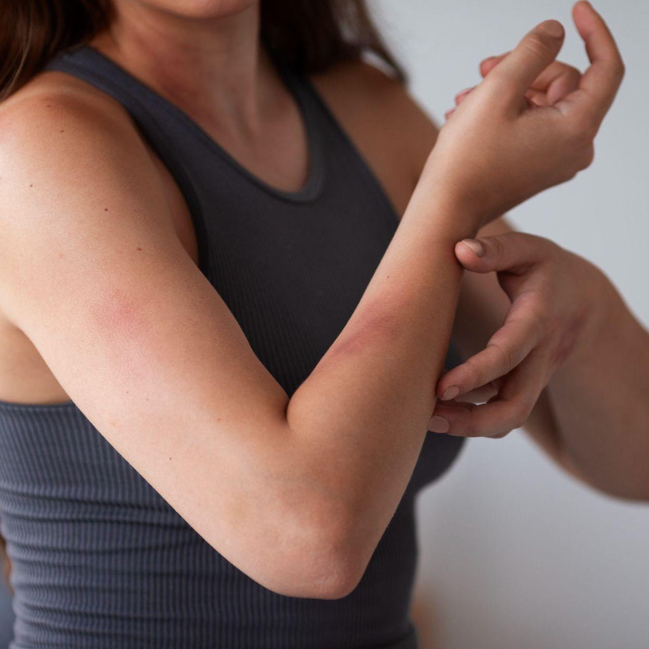
Skin Diseases
01
You can enter a subtitle here if you need it

Slide 5
Abstract
Skin diseases pose significant challenges for timely and accurate diagnosis due to their diverse manifestations and similarities in appearance. The HAM1000 dataset, consisting of 10015 dermoscopic images of various skin lesions, is utilized for training and evaluation purposes.
In order to distinguish between healthy skin and skin that has a disease, as well as to classify skin diseases into their 6 main classes, we develop a multiclass deep learning model. We utilized Deep Learning to train our model.The algorithm that we have used is Convolutional Neural Network (CNN) as it is one of the most preferred algorithms for image classification.

Slide 6
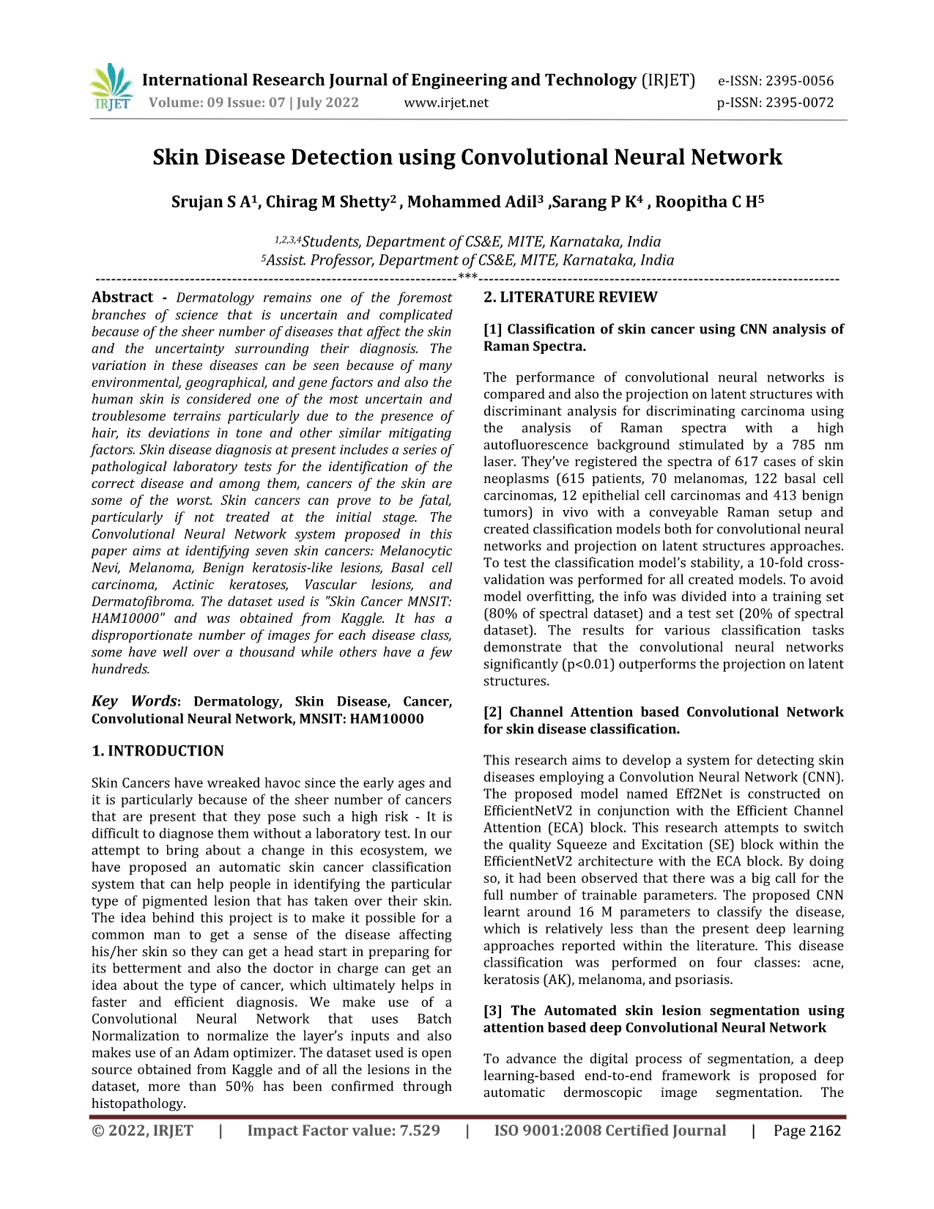
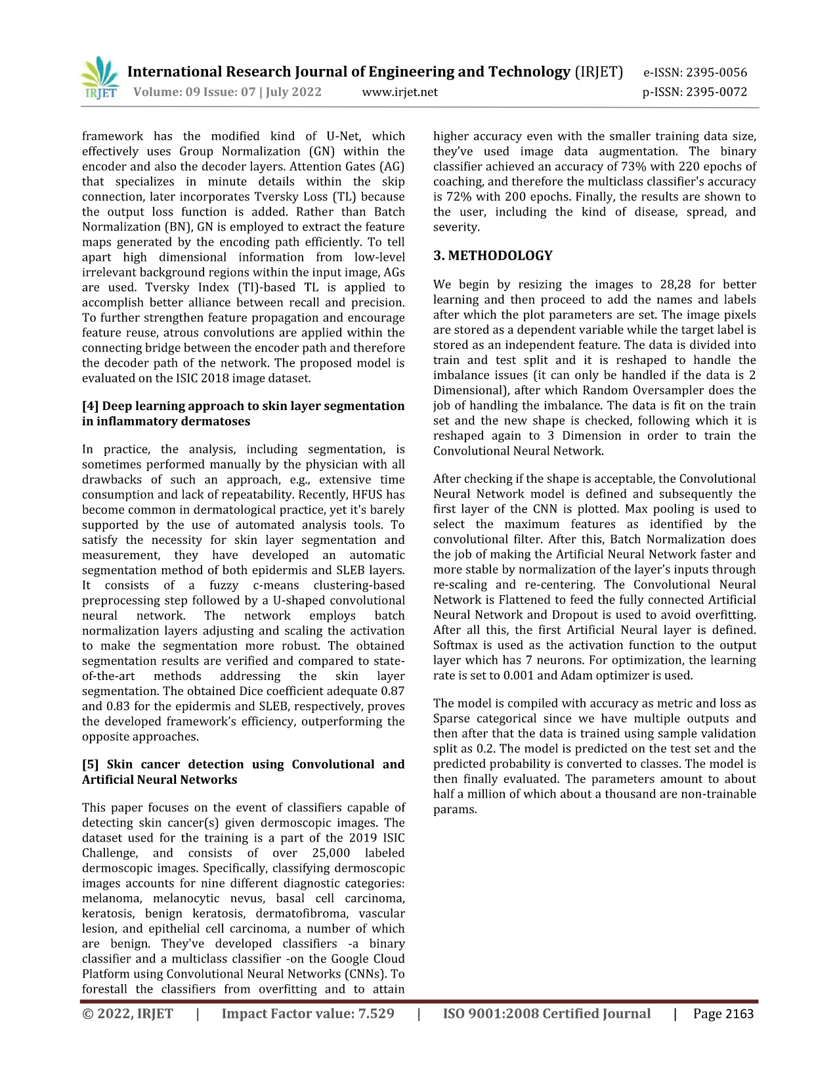
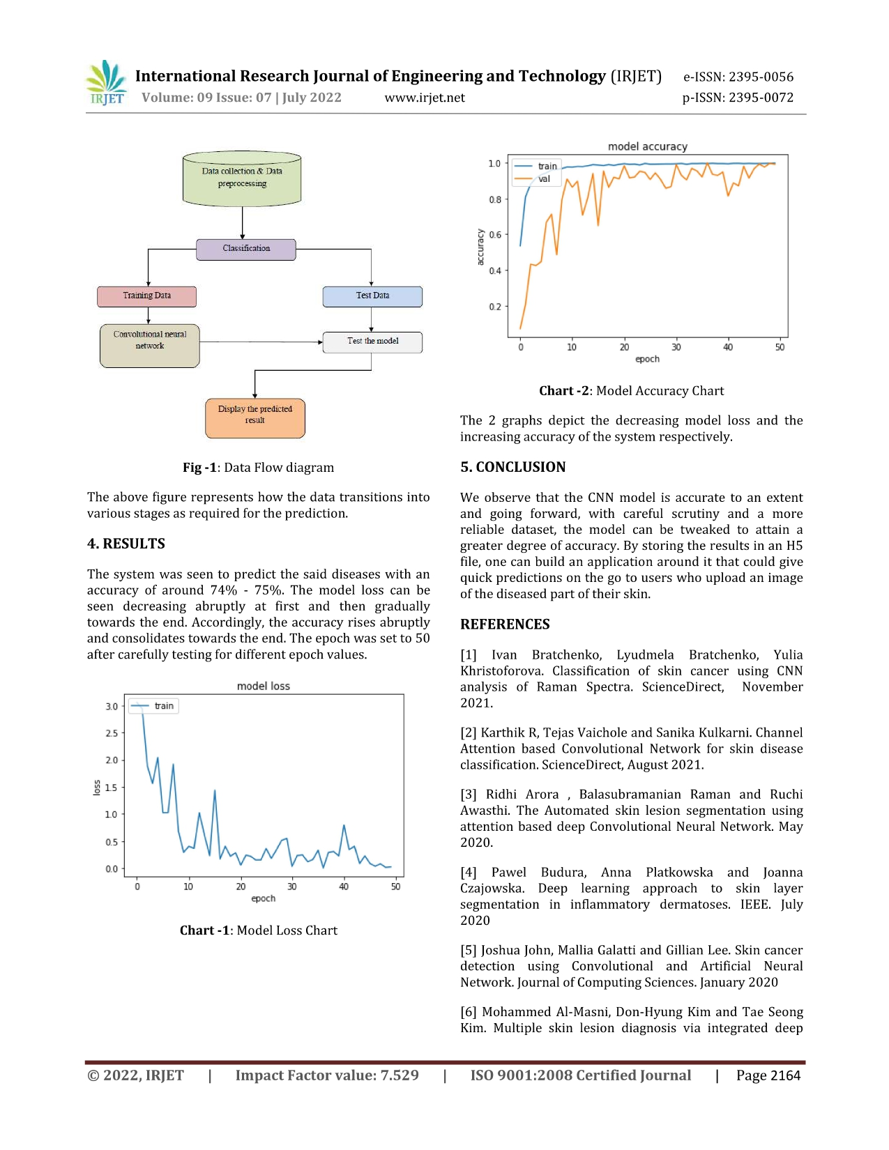
Base Paper
02

Slide 7
Introduction
Skin Disease are occurring almost on all groups of ages among people. The rate of skin disease has been increased due to lifestyle and changing environments .It is observed that every one out of five people are infected with any kind of skin disease.
Skin diseases re more common than other diseases. Skin diseases may be caused by fungal infection, bacteria, allergy, or viruses, etc. But the cost of such diagnosis is still limited and very expensive. Because of its unevenness, tone, hairiness, and other mitigating factors, human skin is one of the most unexpected and difficult surfaces to mechanically synthesizes and analyze. Even while numerous studies are been out to identify and model human skin victimisation, very few have focused on the underlying medical paradigm. Patients typically disregard early symptoms because there aren't any medical services in distant places, which could make the condition worse over time

Slide 8
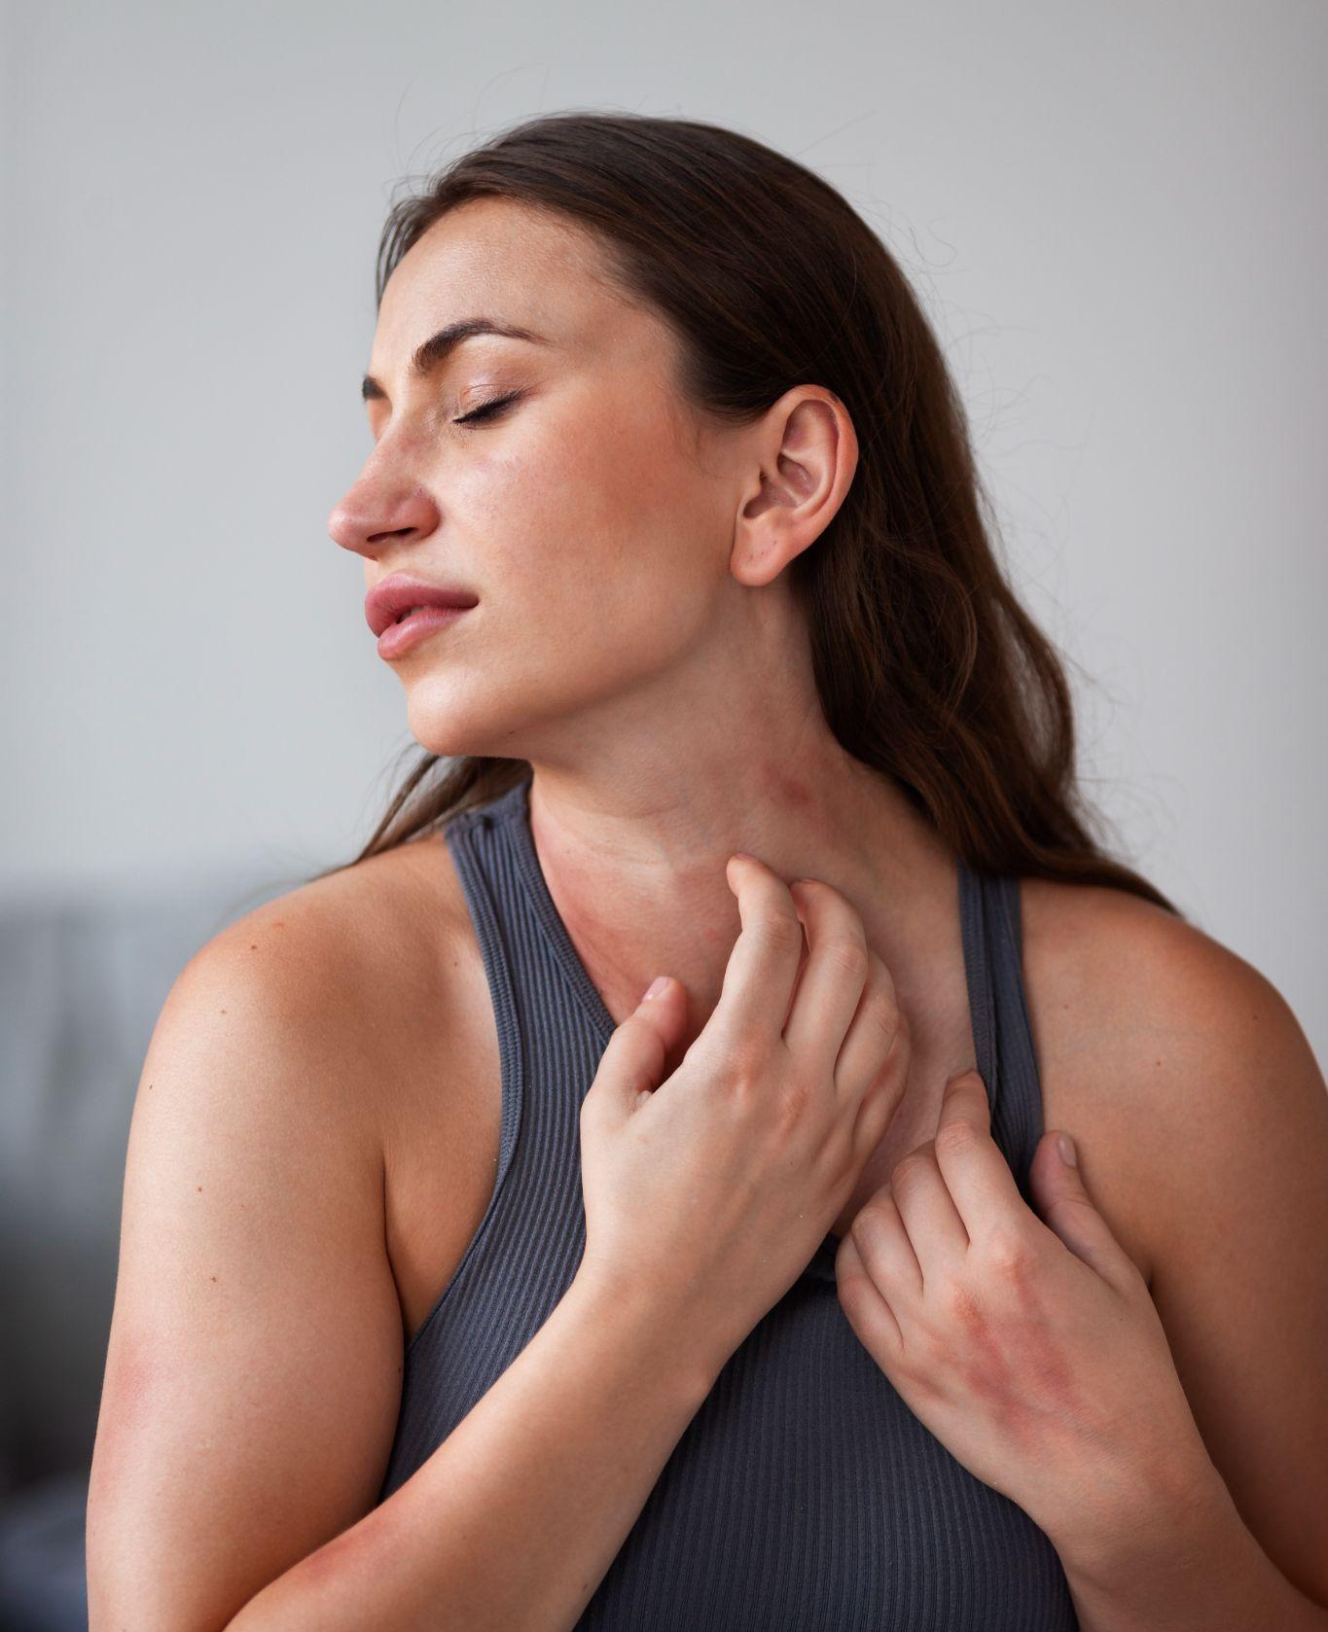
Existing System
The present existing system in skin disease prediction in dermatology mainly relies on the expertise of dermatologists and traditional diagnostic methods. These methods involve visual examination, clinical history, and sometimes histopathological analysis of skin lesions to make a diagnosis.
Visual Inspection: Dermatologists visually examine skin lesions, looking for specific patterns, shapes, colors, and other characteristics that can help in identifying the type of skin disease
Clinical History, Dermoscopy, Skin Biopsy .

Slide 9
Proposed System
The proposed system aims to leverage artificial intelligence, specifically deep learning techniques, to enhance the accuracy and efficiency of skin disease prediction in dermatology. The system will analyze dermoscopic images and clinical data to provide automated and reliable predictions, assisting dermatologists in making more informed decisions.
Key components are:
Data Collection
Data Preprocessing
Deep Learning Model
Training and Validation
User Interface

Slide 10
Disadvantages of existing system
Limited Access to Dermatologists
Diagnostic Errors
Cost
01
02
03
04
05
Time
Underdiagnosis
and
Overdiagnosis

Slide 11
Advantages of Proposed System
1. Time-Efficient
2.Cost-Effective
3. Improved Diagnostic Accuracy
can provide rapid predictions, allowing for quicker diagnosis and treatment, which can be critical in cases where early intervention is crucial for patient outcomes.
Once the system is developed and deployed, it can serve as a cost-effective diagnostic tool, potentially reducing the need for expensive and invasive procedures like skin biopsies.
The learning model can learn complex patterns and features from a large dataset of dermoscopic images
4. Continuous Learning and Improvement
5.Reduced Dependency on Expertise
The deep learning model can be continuously updated and improved as more data becomes available, allowing the system to stay up-to-date with the latest advancements in dermatology.
the system reduces the reliance on the expertise of individual dermatologists,

Slide 12
System Requirements
To run a Convolutional Neural Network (CNN), you will need both software and hardware requirements.
1. Processor: A multi-core processor, such as Intel Core i5 or higher, is recommended for efficient processing of image and video data.
2.RAM: At least 4GB of RAM is recommended for running OpenCV, stream lit and related applications smoothly.
3. Storage
Hardware Requirements

Slide 13
System Requirements
To run a Convolutional Neural Network (CNN), you will need both software and hardware requirements.
1.Programming Language and Framework.
2. Libraries and Packages
3. GPU Support
4. Development Environment
Software
Requirements

Slide 14
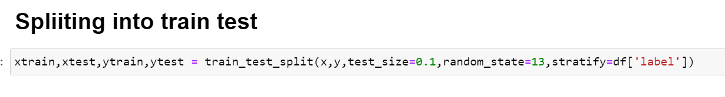
Literature survey
We begin by resizing the images to 28,28 for better learning and then proceed to add the names and labels after which the plot parameters are set. The image pixels are stored as a dependent variable while the target label is stored as an independent feature.

Slide 15
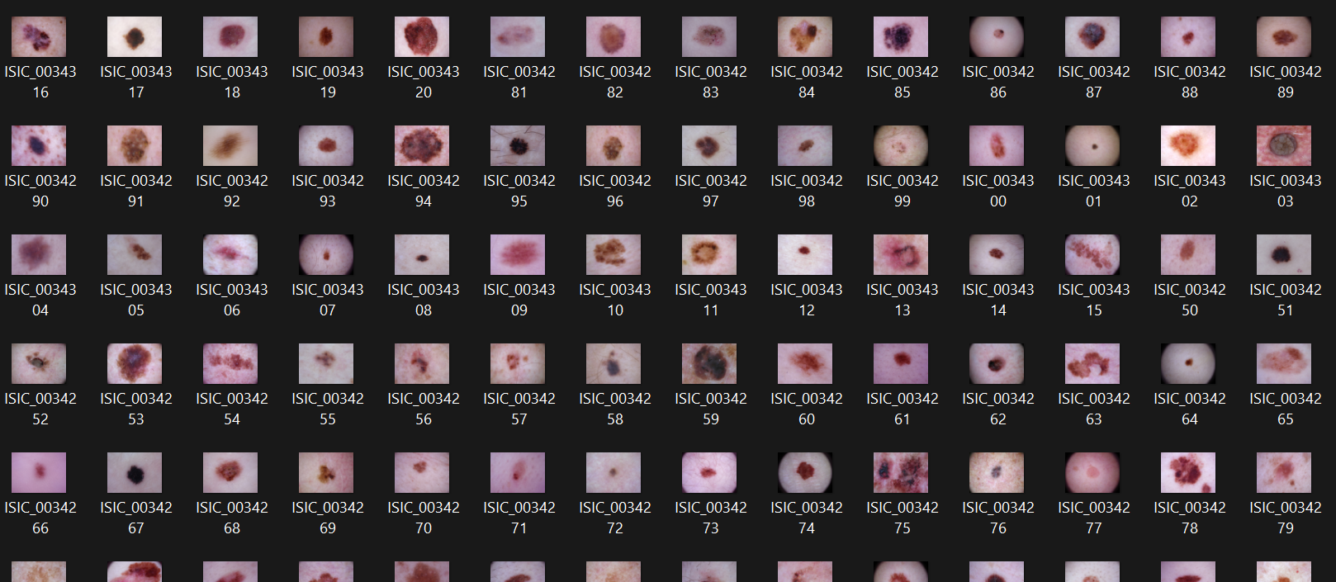
DataSet
HAM10000

Slide 16
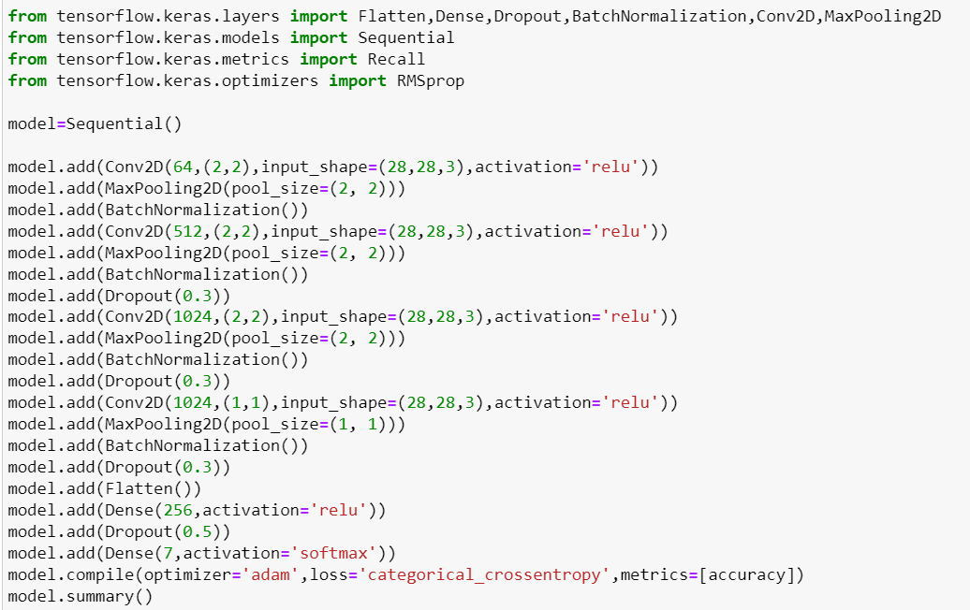
2.Training the model
After checking if the shape is acceptable, the Convolutional Neural Network model is defined and subsequently the first layer of the CNN is plotted. Max pooling is used to select the maximum features as identified by the convolutional filter

Slide 17
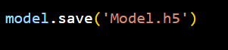
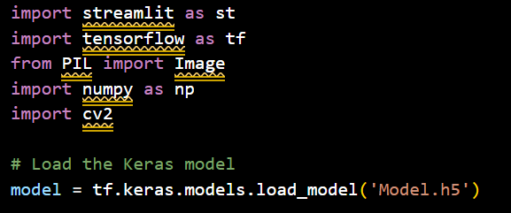
3.Loading the trained model
And then the model is saved as “Model.h5”
Now we use streamlit a popular open-source Python library that is used to create web applications for machine learning projects.It is simple and easy.
We are going to write the python code of using streamlit library in a file name app.py. In this app.py python file we load the previously save model.h5 file.
We even import python libraries like Tensorflow,numpy,opencv.

Slide 18
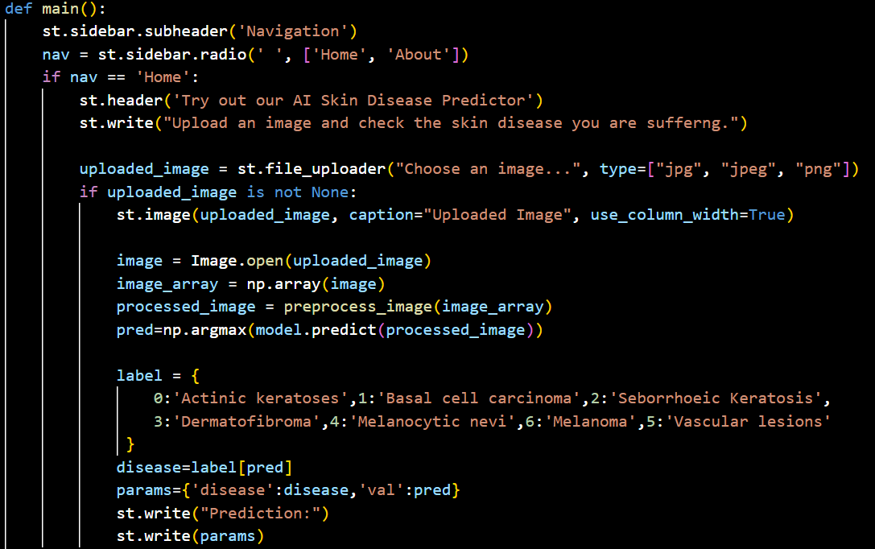
4.Predicting Output
In the main function we write the code which takes image as input using streamlit. Processes the image and converts it into array format .
Then this images it passed as test to the deep learning model trained before.Which returns the predicted output,i.e disease.

Slide 19
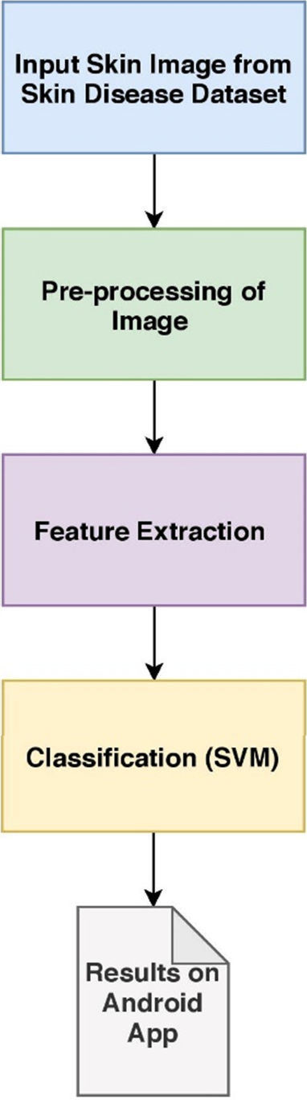
Flow Diagrams

Slide 20
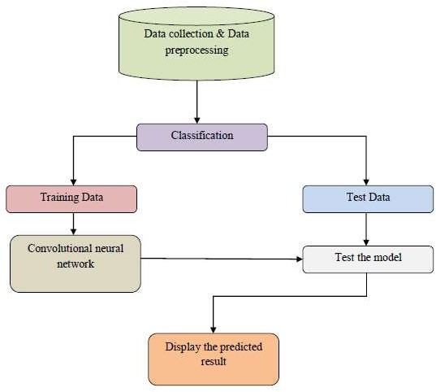
Data Flow Diagram

Slide 21
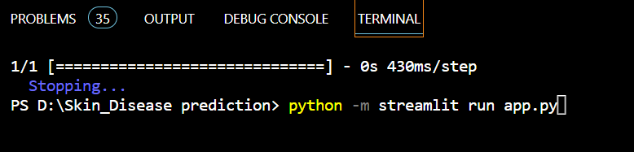
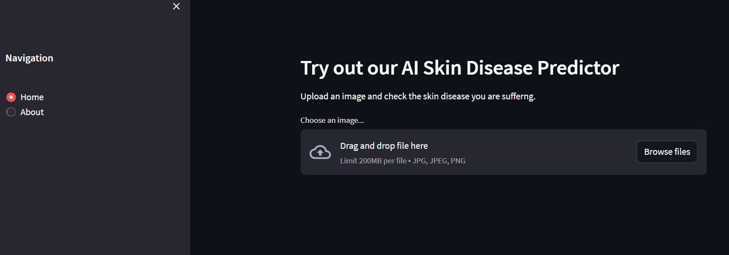
Execution And Result
Execution in commond prompt :
Output :

Slide 22
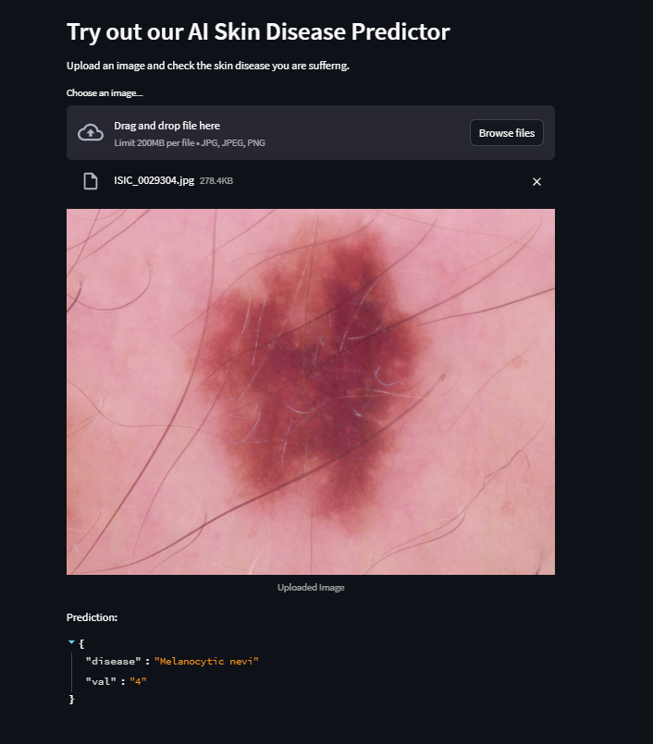
Example 1:

Slide 23
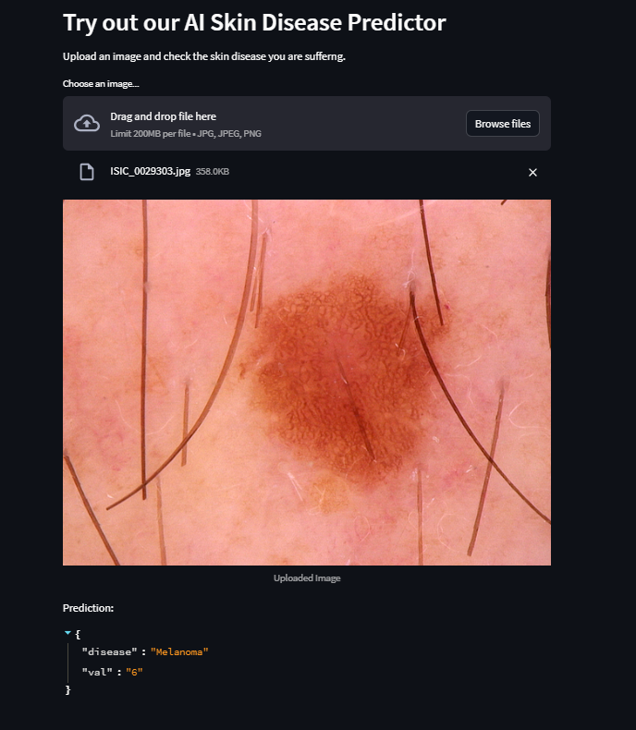
Example 2:

Slide 24
Conclusion

Slide 25
References

Slide 26
Future Scope

